Slide 1
Finding place in Stuttgart, Germany to establish a new restaurant
S. Khandouzi

Slide 2
INTRODUCTION
In Stuttgart, if you are looking for establishing a restaurant, the good idea is finding places that attractive and less crowded by other restaurant. It help costumer to satisfy with your location and enjoy amazing areas after their lunch or before their dinner time around your location.

Slide 3
DATA
A description of the data: the data used to solve this problem is geolocation data collected from FourSquare. Data is a single dataframe, containing at least a location of the restaurants. Explanation of the location data is a standard tuple (lat, lng), where lat stands for latitude and lng for longitude. Example of the data used in analysis is shown in table 1.
Data will be used in the following way: by knowing the locations of already existings restaurants. It is possible to apply many techniques of unsupervised learning technique, but the kernel density estimation (KDE) will be used to looking for the area of influence of the current restaurants.

Slide 4
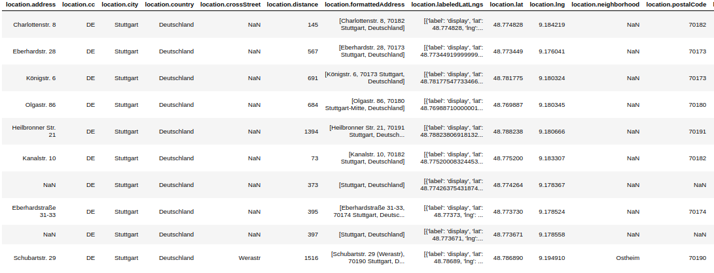
Data
Figure 1 – example of the table extracted from the FourSquare

Slide 5
METHODOLOGY
A density estimation was used to measure the proximity of the restaurants, Folium was used to print and visualize the map. Most data were picked using Foursquare API, the positions of bares and cafeterias are in Figure 1, the blue circles are the cafeterias and the green one are the bares. Data used to test the kernel was generated manually using some coordinates from Porto Alegre. It is possible to see the generated test data in Figure 2.

Slide 6
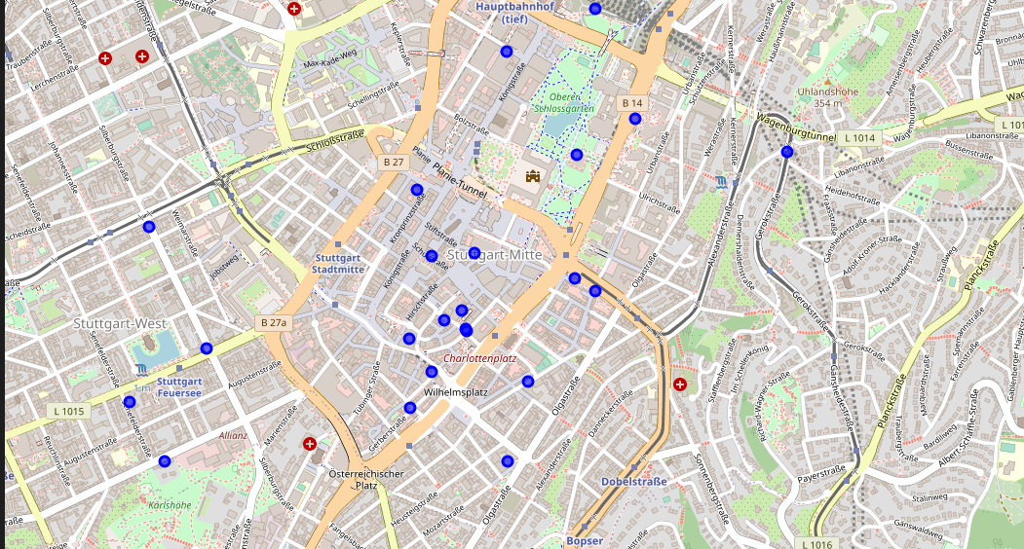
METHODOLOGY
Figure 2 – areas which is attractive for the tourists

Slide 7
RESULTS
Looking the Figure 3, you can take some assumption. If you want to go near the castle you will not find many options but if you want to go near “scharlottenplatz” you will find a lot of restaurant near around.

Slide 8
RESULTS
Figure 3 – areas with blue circle is the restaurant locations

Slide 9
DISCUSSION
To select a location for the restaurant you can run further analysis about the kind of the restaurant or the correlation between your restaurant inner core with the around area.
Ex. If you want to establish modern restaurant it is not good option to establish it near around the old city. Because it is not good looking for tourist who searching for old manner around there.

Slide 10
CONCLUSIONS
This is the first kind of analysis to establishing restaurants. But with this analyze, person who wants to establish a restaurant could find out which locations is less crowded by the restaurants and which tourists areas do not have good amount of restaurants.
Then for selected location run further analysis.

